Slide 1
SMART HOME AUTOMATION SYSTEM Ragavendar 210701202 Raghav 210701203

Slide 2
Agenda
Introduction and Purpose of the project
Components used
Circuit diagram
Results
Conclusion and Future Scope

Slide 3
INTRODUCTION AND PURPOSE OF THE PROJECT

Slide 4
INTRODUCTION
The use of automation is emerging with the help of internet providing possibility of objects to work it-self.
With recent advancements to the fast speed internet, IoT will be playing a vital role in our daily tasks in present and future.
IoT is offering feasibility and effectiveness to the system that are based upon it. These modern technologies are creating comfort and standard way of living because of its time, energy and cost efficiency.
In this modern world, where things are going to be on our finger tips, our daily household appliances will also be controlled with our smartphones.
This will allow us to manage the usage smartly, and can help in building of an eco-friendly environment.

Slide 5
Purpose of the project
The primary purpose of home automation systems using IoT is to create a smarter, safer, and more efficient living environment.
These systems leverage the power of interconnected devices to provide enhanced convenience, security, energy efficiency, and overall quality of life for homeowners.
By automating routine tasks and enabling remote monitoring and control, IoT-based home automation systems make homes more responsive to the needs and preferences of their occupants, ultimately leading to a more comfortable and efficient living experience.

Slide 6
COMPONENTS USED

Slide 7
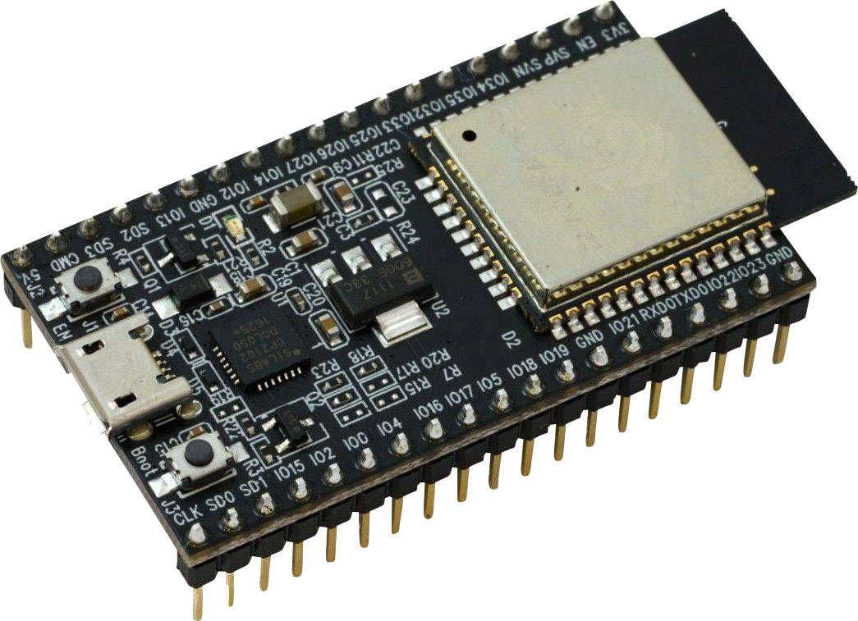
ESP 32
ESP32 is a low-powered, low-cost microcontroller (MCU) board
Dual-Core Processor: The ESP32 features a dual-core Tensilica Xtensa LX6 microprocessor, offering significant computational power for handling complex tasks.
Wi-Fi and Bluetooth Connectivity: It integrates both Wi-Fi (802.11 b/g/n) and Bluetooth (v4.2 BR/EDR and BLE) capabilities, allowing for robust wireless communication.
Rich Peripheral Set: The ESP32 includes a wide range of peripherals such as GPIOs, ADCs (Analog-to-Digital Converters), DACs (Digital-to-Analog Converters), UARTs, SPI, I2C, I2S, PWM, and touch sensors.
Low Power Consumption: Designed for energy efficiency, the ESP32 supports various power-saving modes, making it suitable for battery-powered applications.
High Performance: With clock speeds up to 240 MHz and ample RAM, the ESP32 can handle demanding processing tasks and real-time operations.

Slide 8
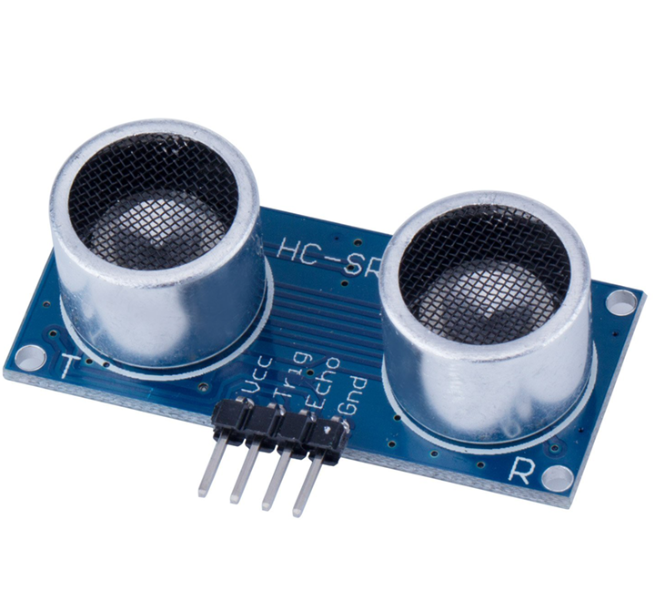
Ultrasonic sensor
An ultrasonic sensor is an electronic device used to measure distance or detect objects by using ultrasonic waves. It works on the principle of echolocation, similar to how bats navigate.
Key Features
Components:
Transmitter: Emits ultrasonic waves (typically at 40 kHz).
Receiver: Detects the waves that bounce back from an object.
Working Principle:
The sensor sends out a burst of ultrasonic sound waves.
These waves travel through the air and reflect back upon hitting an object.
The sensor calculates the distance based on the time it takes for the waves to return.
Distance Measurement:
Commonly used to measure distances ranging from a few centimeters to several meters.
The formula used is: Distance = (Time * Speed of Sound) / 2.

Slide 9
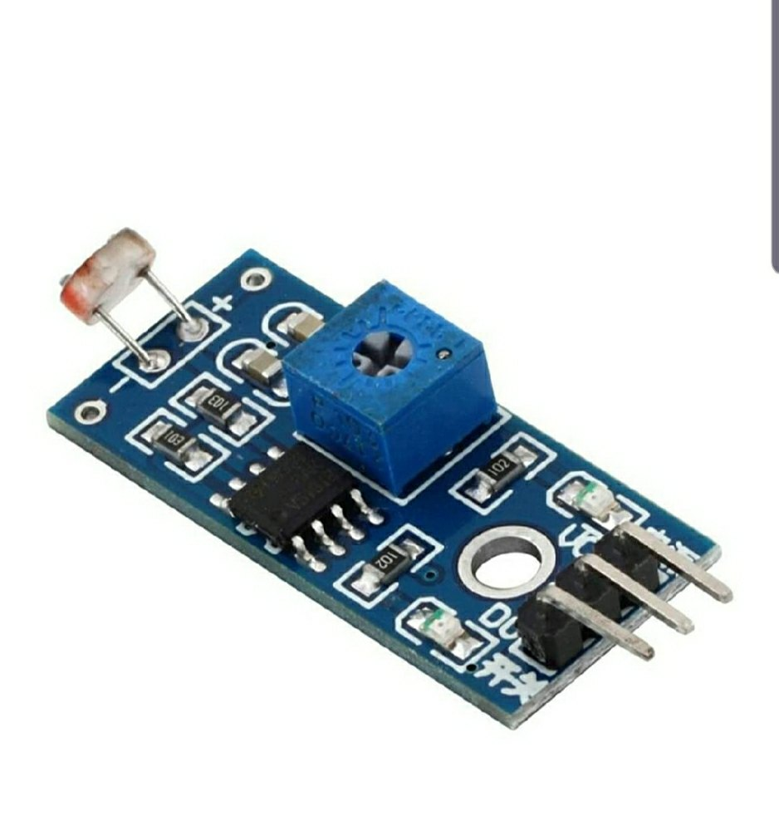
LDR SENSOR
A Light Dependent Resistor (LDR), also known as a photoresistor, is an electronic component whose resistance changes based on the intensity of light falling on it
Working Principle:
When light photons hit the surface of the LDR, they provide energy to electrons, freeing them and allowing current to flow more easily.
In darkness or low light, the LDR has high resistance, limiting the current flow.

Slide 10
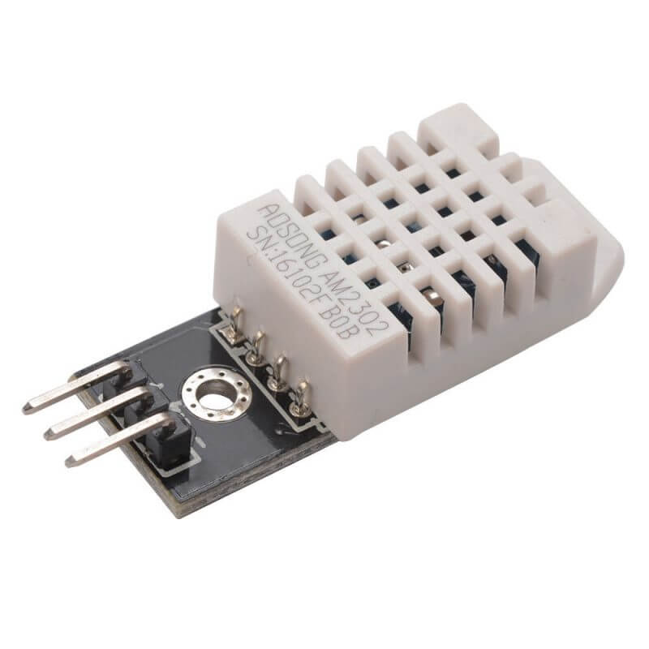
DHT22 SENSOR
The DHT22, also known as AM2302, is a digital sensor that measures both temperature and humidity. It is widely used in environmental monitoring and control applications due to its high accuracy and reliability.

Slide 11
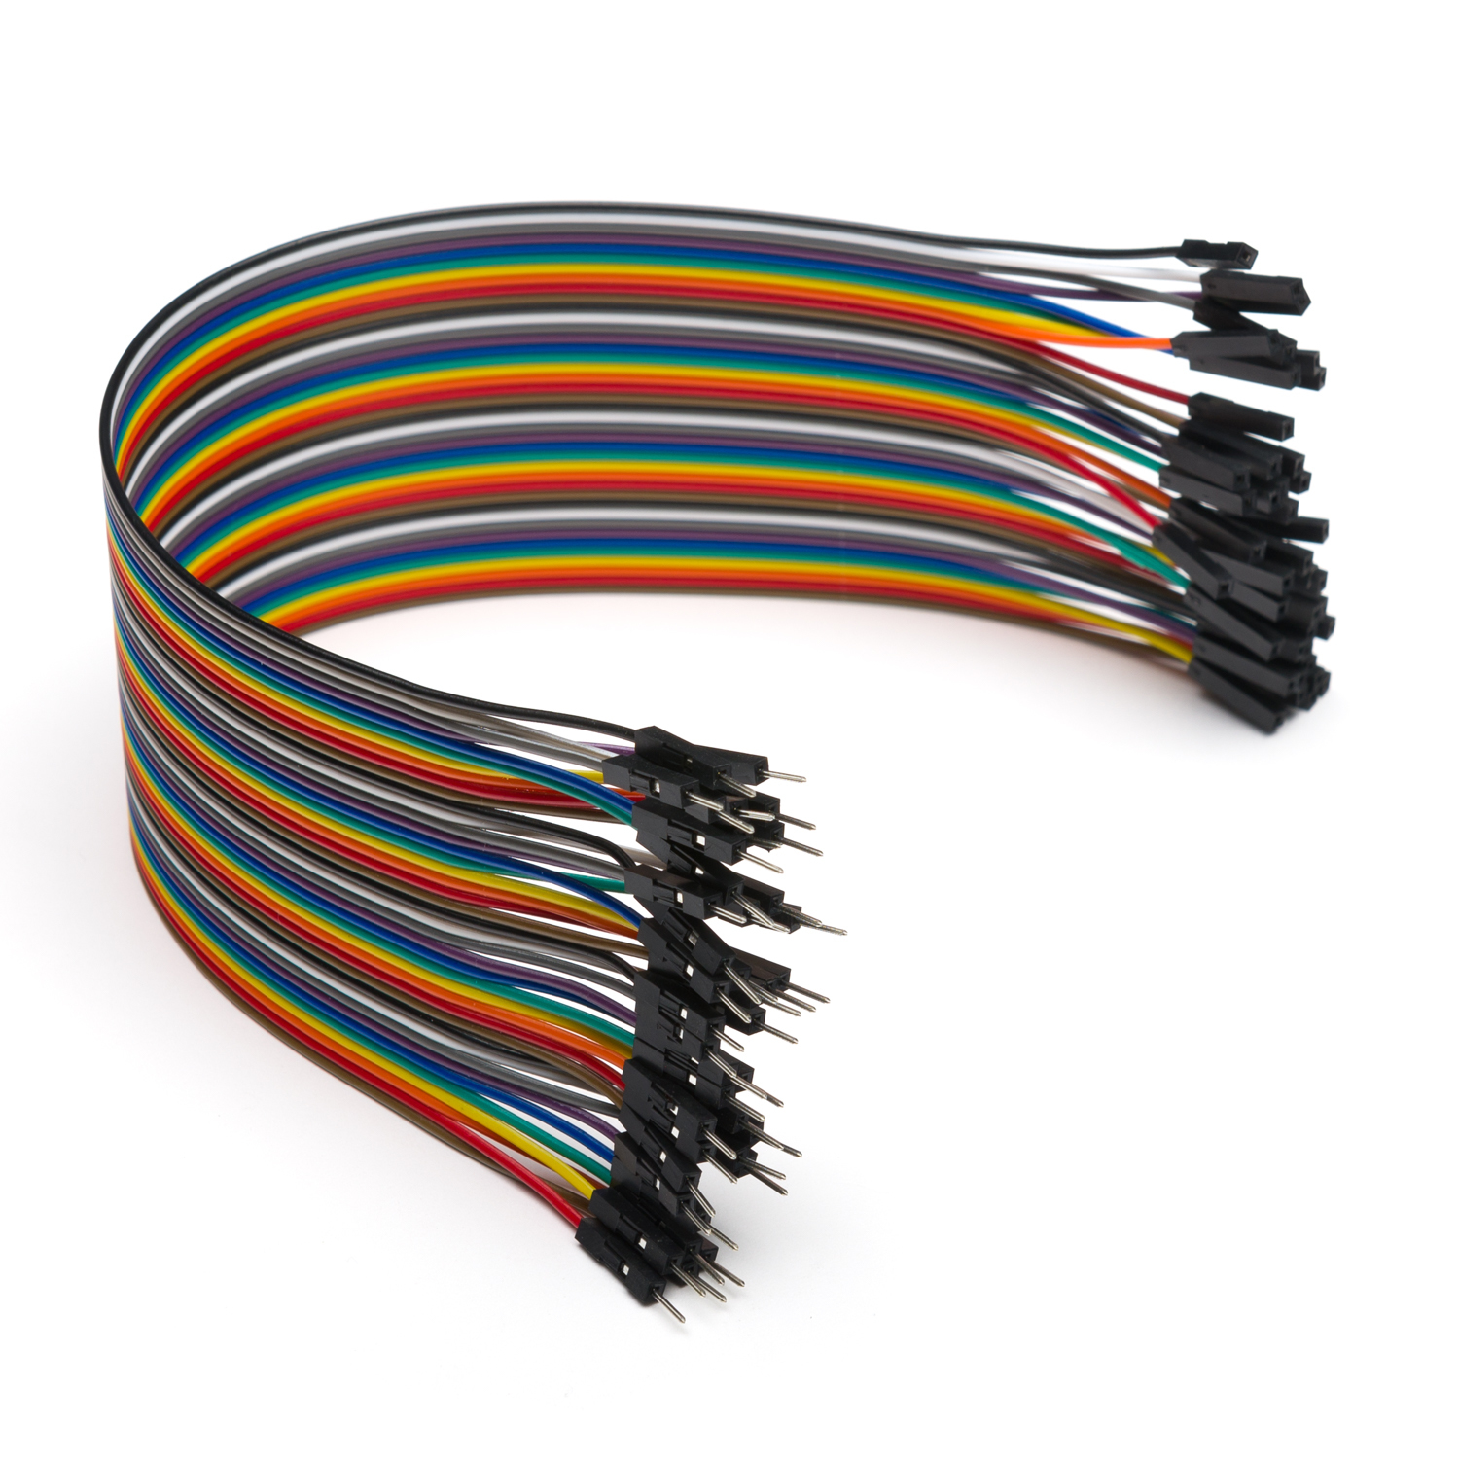
Jumper wires
Jumper wires are essential components used in electronics and prototyping to create temporary or permanent connections between the components on a breadboard or other circuit boards.
Types of Jumper Wires:
Male-to-Male
Male-to-Female
Female-to-Female

Slide 12
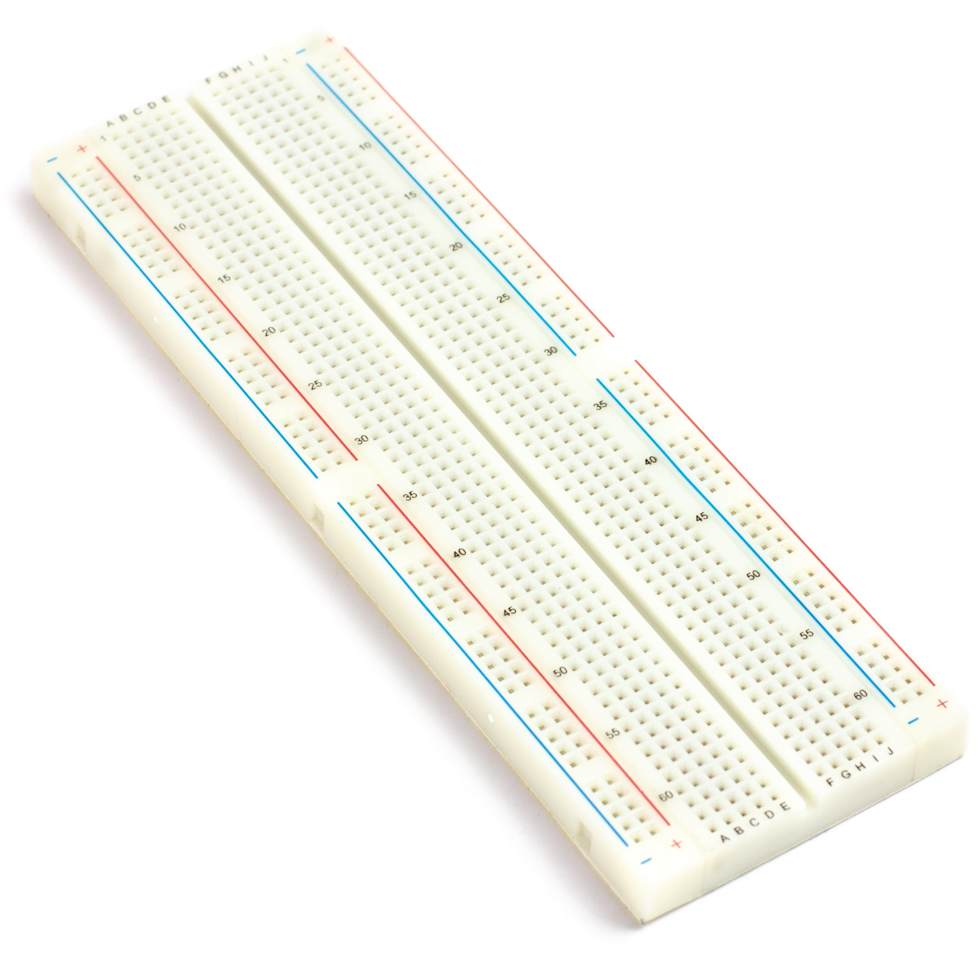
BREAD BOARD
A breadboard is a fundamental tool used in electronics for prototyping and testing circuits without the need for soldering. It allows for quick and easy assembly and modification of electronic circuits.

Slide 13
CIRCUIT DIAGRAM

Slide 14
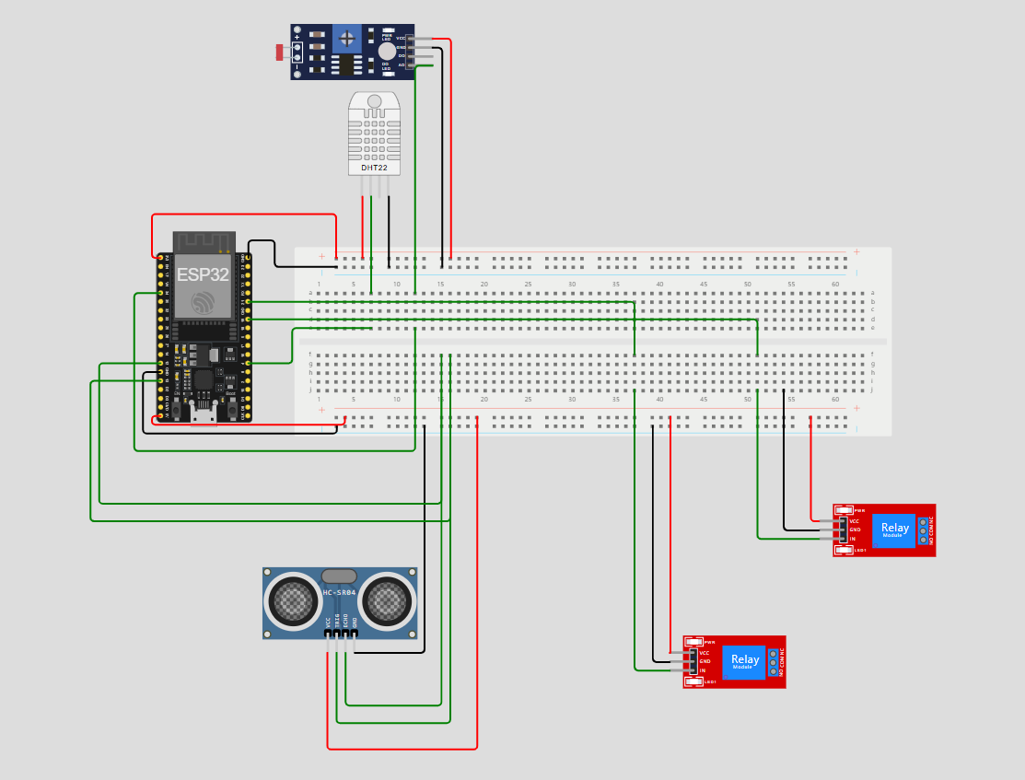

Slide 15
ARCHITECTURE DIAGRAM

Slide 16
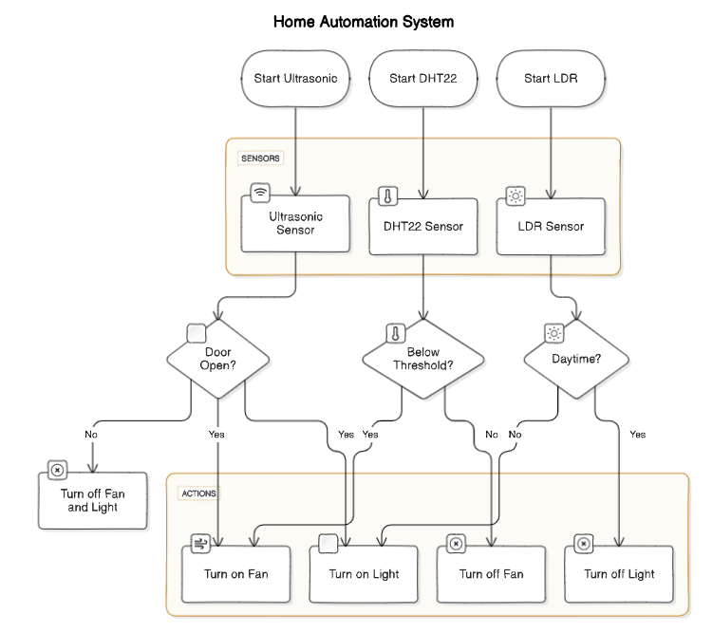

Slide 17
RESULTS/OUTPUT

Slide 18
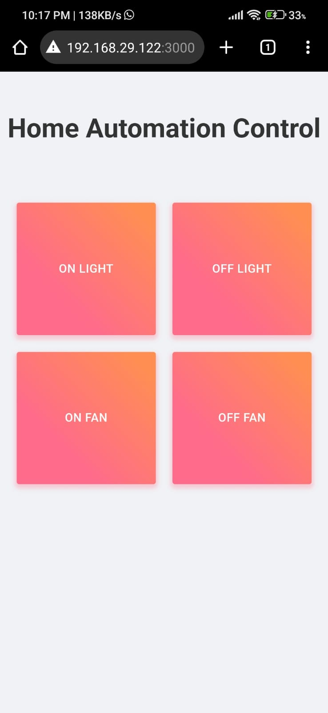
Home Automation User Interface that is accessible any where private within a network

Slide 19
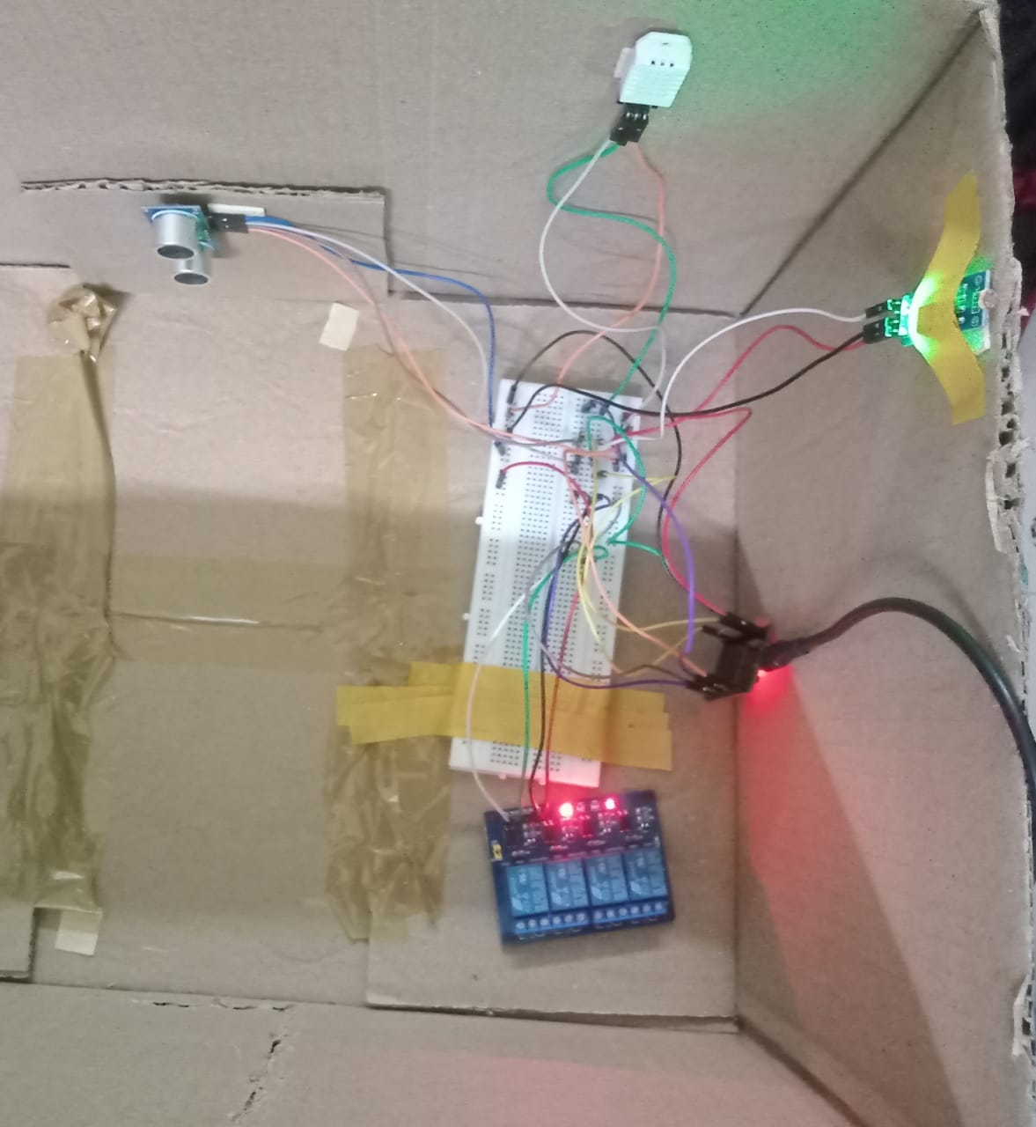
The connections made to the Home Automation System with the esp32.

Slide 20
CONCLUSION AND FUTURE SCOPE

Slide 21
CONCLUSION
In this project, a simple yet effective home automation system was developed using various components like sensors, actuators, and a microcontroller.
The system allows for remote monitoring and control of devices such as LEDs, fans, and bulbs through a web interface.
Additionally, environmental parameters like temperature, humidity, light intensity, and presence detection were integrated for enhanced automation.

Slide 22
FUTURE WORK
Platform Expansion
Speech Interaction
Voice Recognition
Security Enhancement

Slide 23
Thank you

